Slide 1
Intro to Variables
Mr Mack 2021

Slide 2
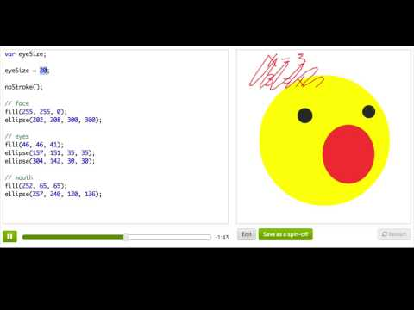
Variables

Slide 3
After running this code:
var x = 50;
var y = 15;
What is the value of the y variable?
Notes:
🍐 This is a Pear Deck Text Slide
🍐 To edit the type of question, go back to the "Ask Students a Question" in the Pear Deck sidebar.

Slide 4
In the following code, we define two variables, w and h, and use them to draw an ellipse and a rectangle:
var w = 20;
var h = 15;
rect(10, 10, w, h);
ellipse(10, 10, w, h);
How tall is each one of the shapes?
Notes:
🍐 This is a Pear Deck Text Slide
🍐 To edit the type of question, go back to the "Ask Students a Question" in the Pear Deck sidebar.

Slide 5
The following code draws a face with a mouth (with no eyes!), using two variables:
var faceS = 100;
var mouthS = 30;
ellipse(200, 200, faceS, faceS);
ellipse(200, 220, mouthS, mouthS);
How wide is the second ellipse that draws the mouth?
Notes:
🍐 This is a Pear Deck Text Slide
🍐 To edit the type of question, go back to the "Ask Students a Question" in the Pear Deck sidebar.

Slide 6
In the following code, we define a variable and use it to draw a rectangle:
var rectWidth = 20;
rect(10, 10, rectWidth, rectWidth);
How wide is the rectangle?
Notes:
🍐 This is a Pear Deck Text Slide
🍐 To edit the type of question, go back to the "Ask Students a Question" in the Pear Deck sidebar.

Slide 7
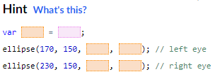
Practice: Bucktooth Bunny
Bucky's eyes are drawn as ellipses, and the last two numbers represent their width and height. Create a variable that stores the eye size and use that to change the size of both eyes. Once you've done that, have fun dragging the slider to make HUGE eyes and teeeeny tiny eyes.
Change the eyes

Slide 8
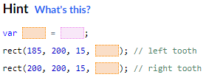
Practice: Bucktooth Bunny
Bucky's buckteeth are drawn as rectangles, and the last number is the height of the rectangle. Create a variable to store the length of the teeth so that you can change the length of both buckteeth at once.
Longer teeth!

Slide 9
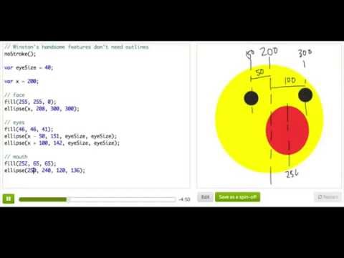
More on Variables

Slide 10
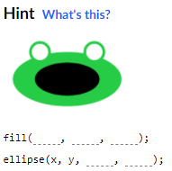
Practice: Funky Frog
Our frog has no mouth! Use the ellipse function to draw a wide mouth on the frog's face, centering the mouth at the same x and y as the face. Make it big enough to eat a lot of flies!
A mouth!

Slide 11
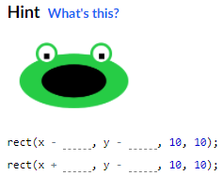
Practice: Funky Frog
The frog already has eyeballs, but no pupils. How will he find the tasty flies if he can't see them?? Draw them using two rectangles, and use the x and y coordinates to position them inside the eyeballs (adding or subtracting as necessary).
Hint: Take a look at the code for the eyeballs and do something similar to position the pupils.
Draw eyes

Slide 12
Review: Variables
Here's what we covered in this tutorial on variables:
A variable is a way to store values. To use a variable, we must both declare it—to let the program know about the variable—and then assign it—to let the program know what value we are storing in the variable.

Slide 13
Review: Variables
Here's how we would declare a variable named "xPos":
var xPos;
Now, we can assign xPos to hold the value 10:
xPos = 10;
If we want to—and we often do!—we can declare and assign in one statement:
var xPos = 10;
If, for some reason, we want to change the value of a variable later, we can re-assign it:
var xPos = 10;
// some time later ...
xPos = 20;
We'll soon see why re-assignment can be useful when we want to animate our drawings.

Slide 14
Review: Variables
How can we pick names for our variables? For variables in JavaScript, follow these rules:
Variable names can begin with letters, or the symbols $ or _. They can only contain letters, numbers, $ and _. They cannot begin with a number. "myVariable", "leaf_1", and "$money3" are all examples of valid variable names.
Variable names are case sensitive, which means that "xPos" is different from "xpos", so make sure you are consistent.
Variable names can't be the same as existing variable names, and there are a lot in our ProcessingJS programming environment. If you ever see an error pop up like "Read only!", try changing your variable name.
Variable names should be clear and meaningful; for example, instead of "ts", use "toothSize".
Variable names should use camel case for multiple words, like "toothSize" instead of "toothsize" or "tooth_size".
We'll use variables a lot when we learn animation in the next tutorial, so ask questions here if you don't understand something about them.

